Slide 2
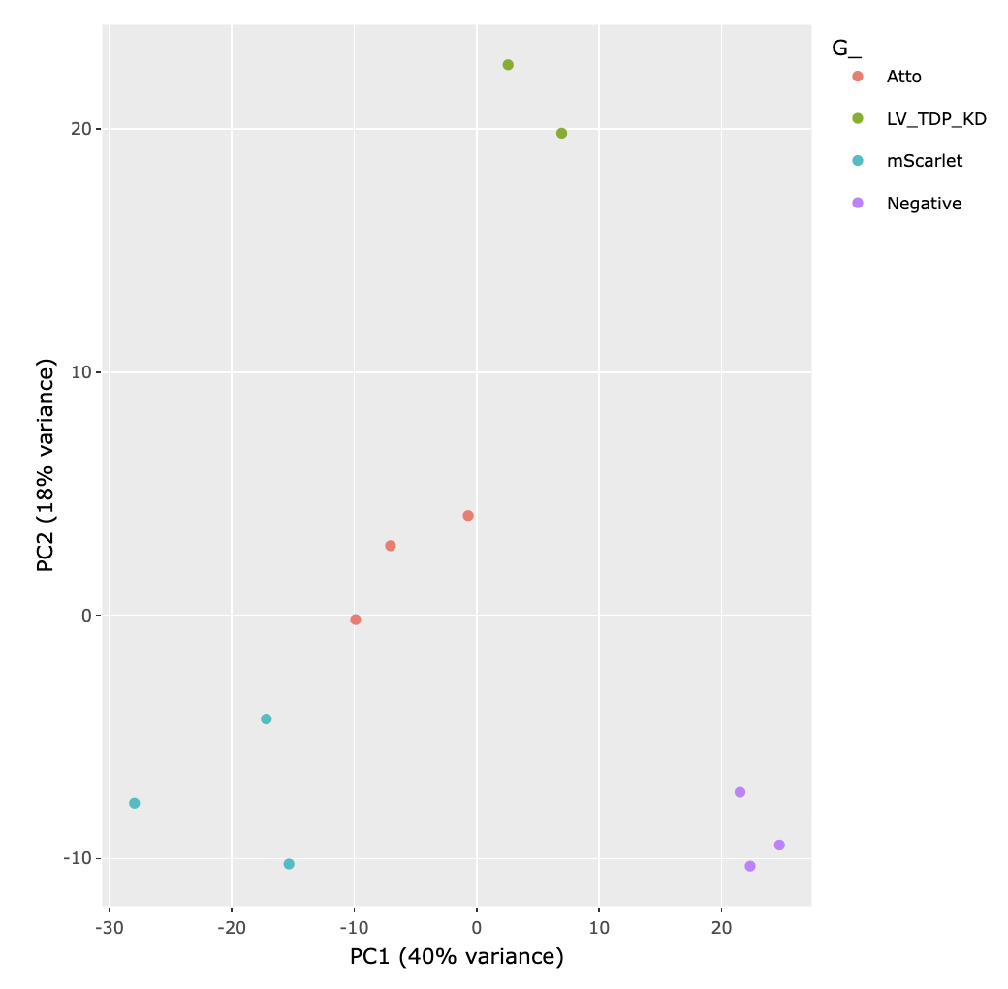
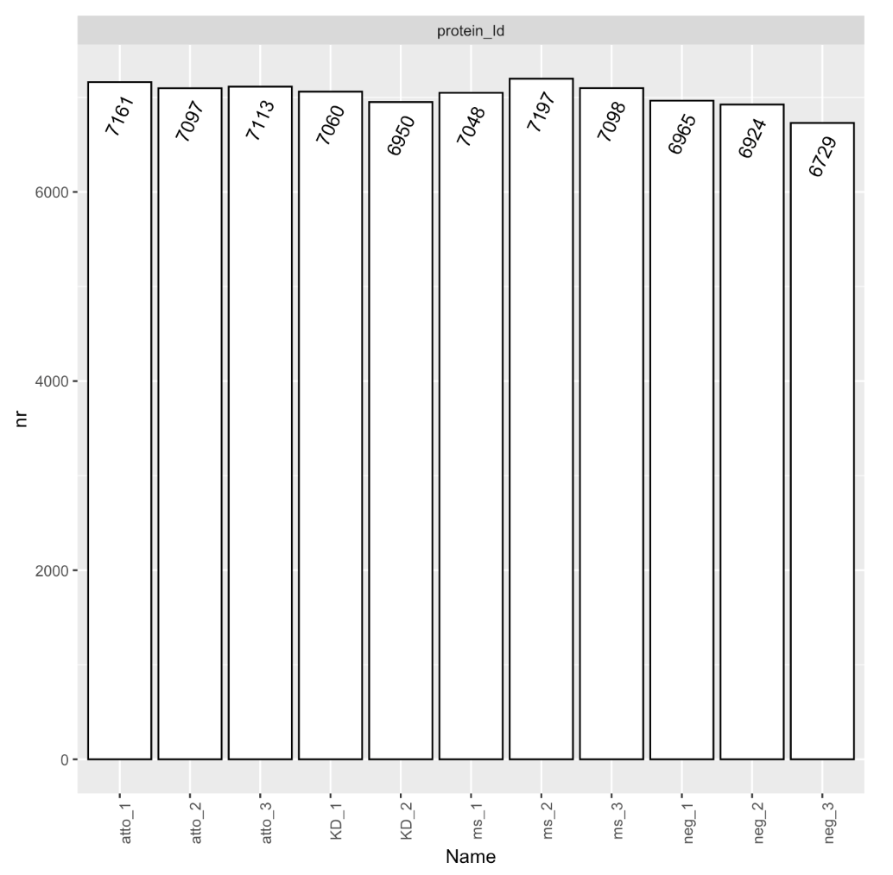
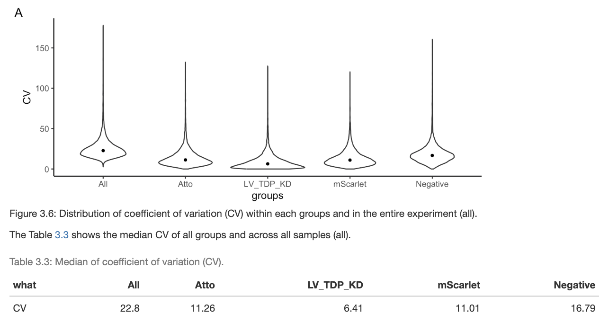

Slide 3
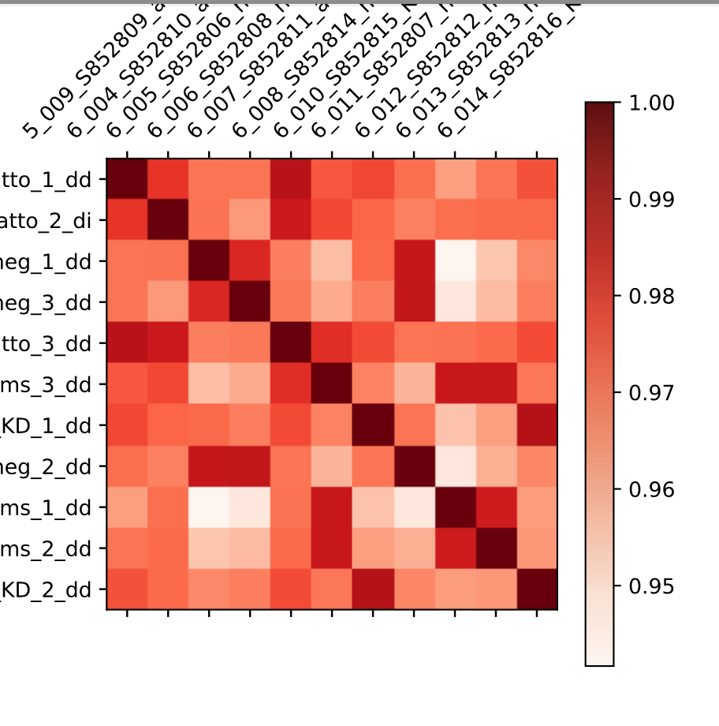
> unique(dia_cryp_only$Protein.Ids)
[1] "CRYP-EP400_ENST00000389561_2" "CRYP-KIAA0753_ENST00000361413_0"
[3] "CRYP-EP400_ENST00000389561_0" "CRYP-ZNF423_ENST00000561648_0"
[5] "CRYP-TRRAP_ENST00000628380_2" "CRYP-AC022966_1_ENST00000542802_chr17_78836897_78836976"

Slide 4
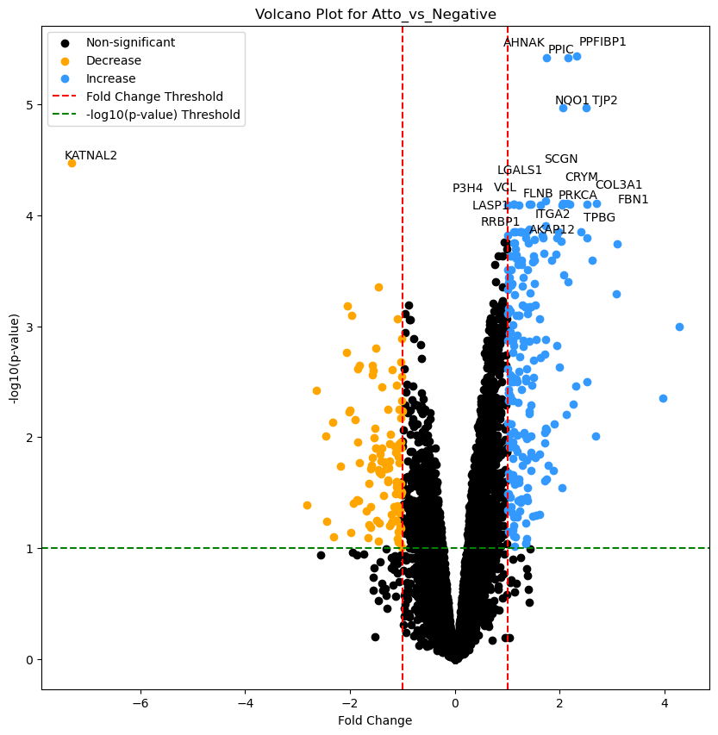
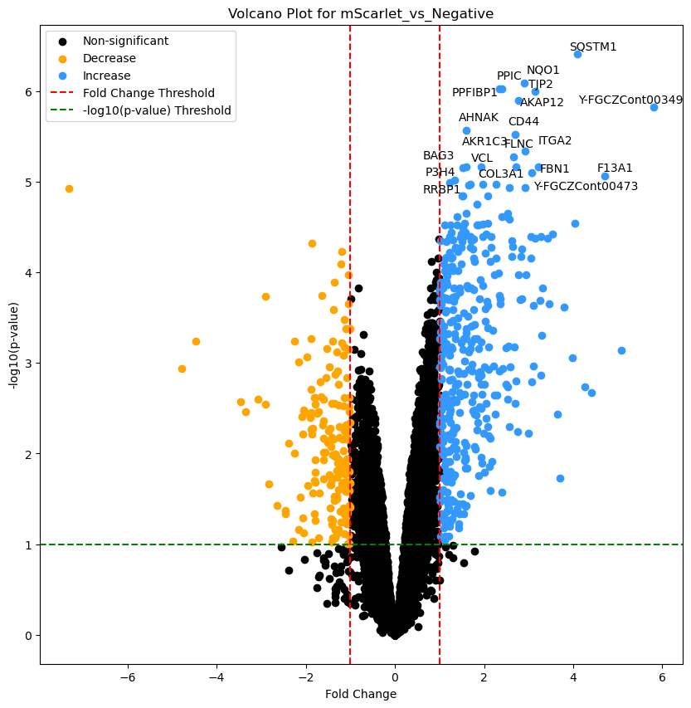
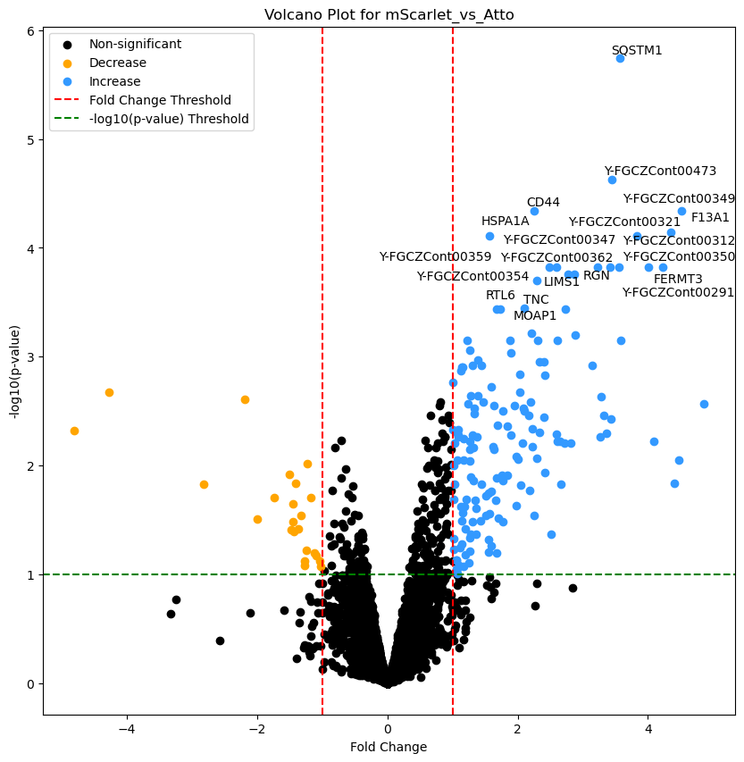
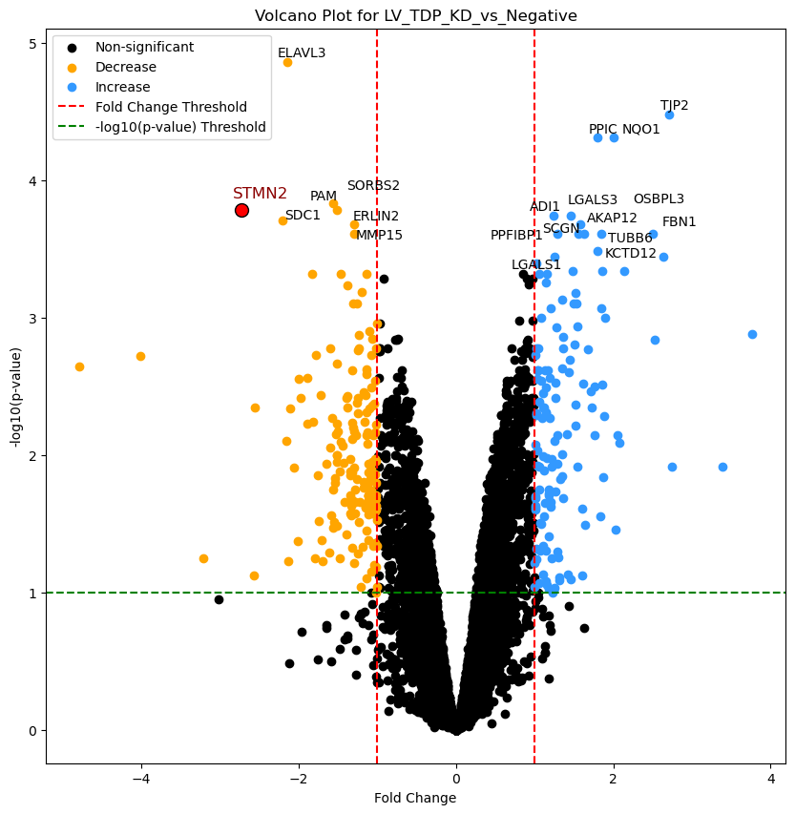
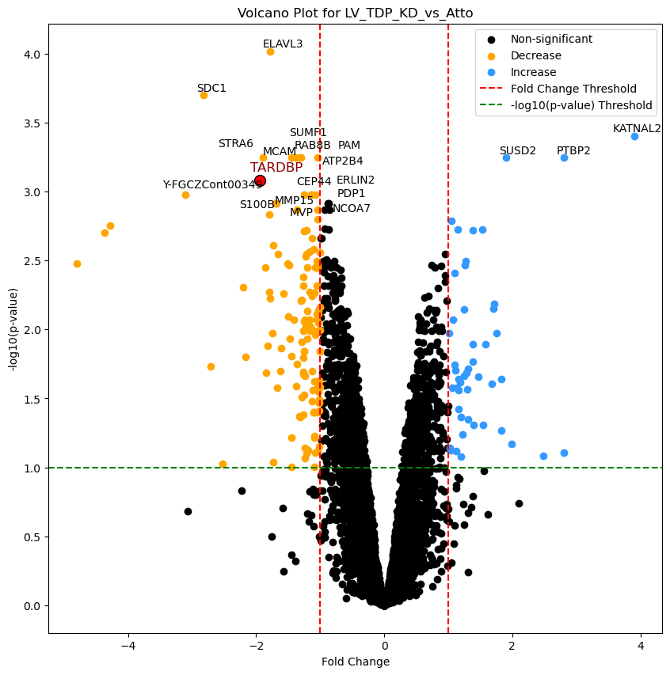
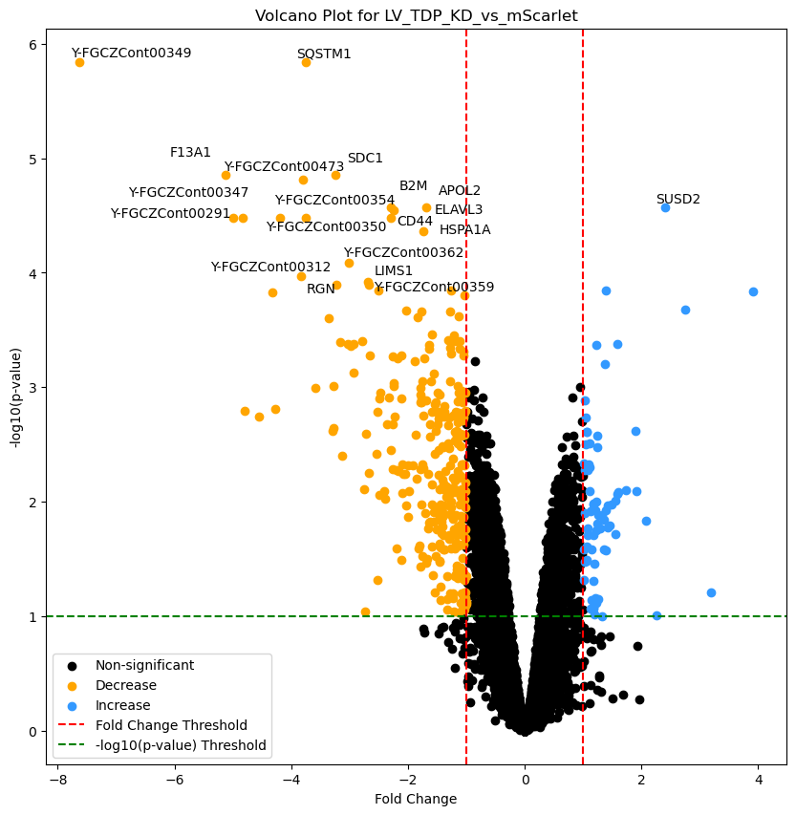
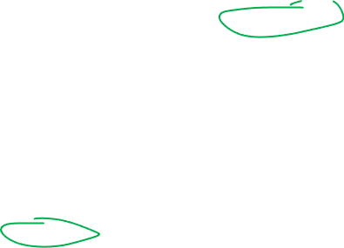
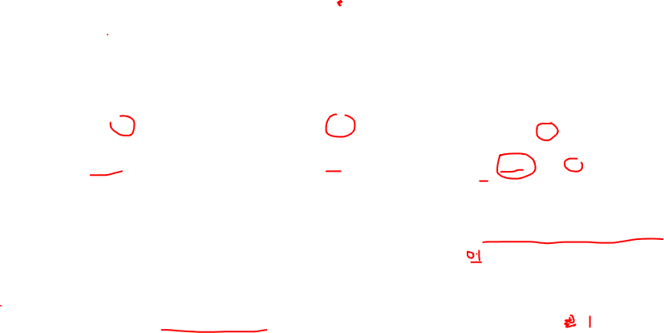
109
212
182
416
23
156
295
166
139
131
47
71
highlighted_proteins = ['TARDBP', 'STMN2', 'ACTl6B', 'ETV5', 'UNC13A']

Slide 5
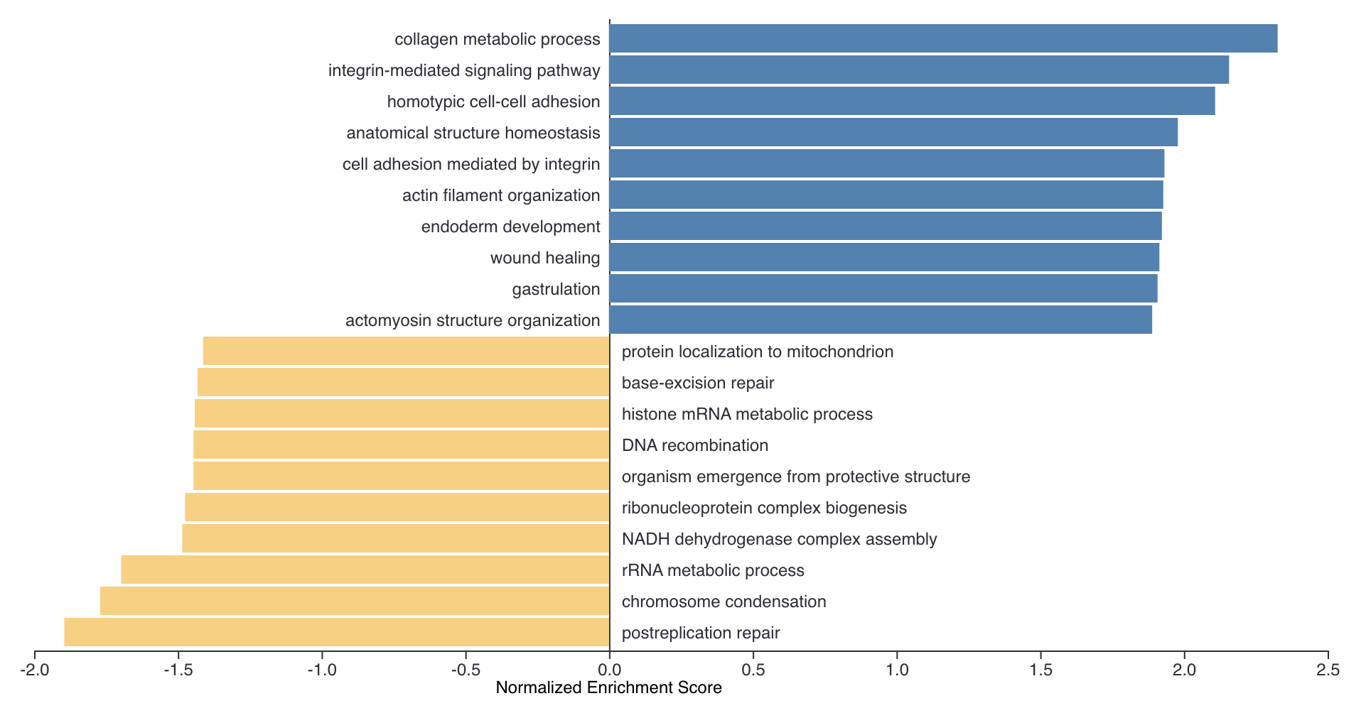
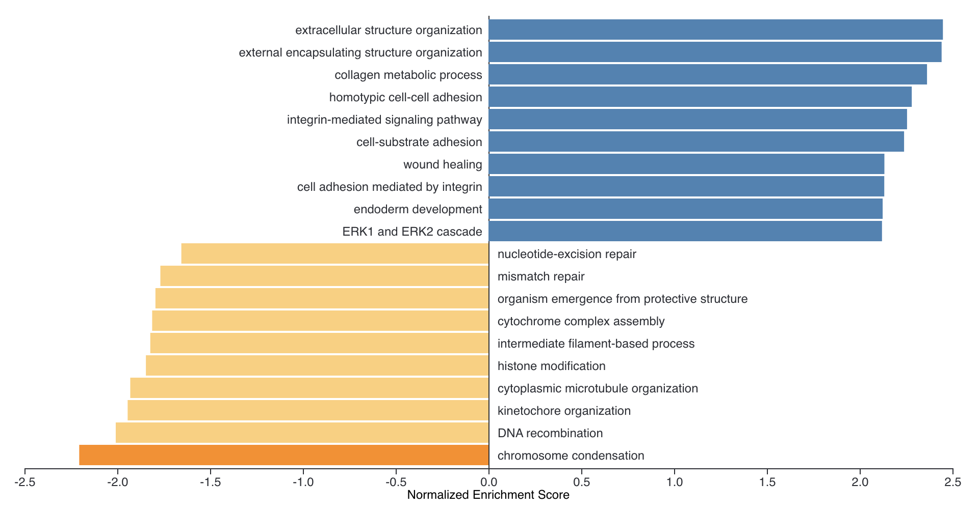
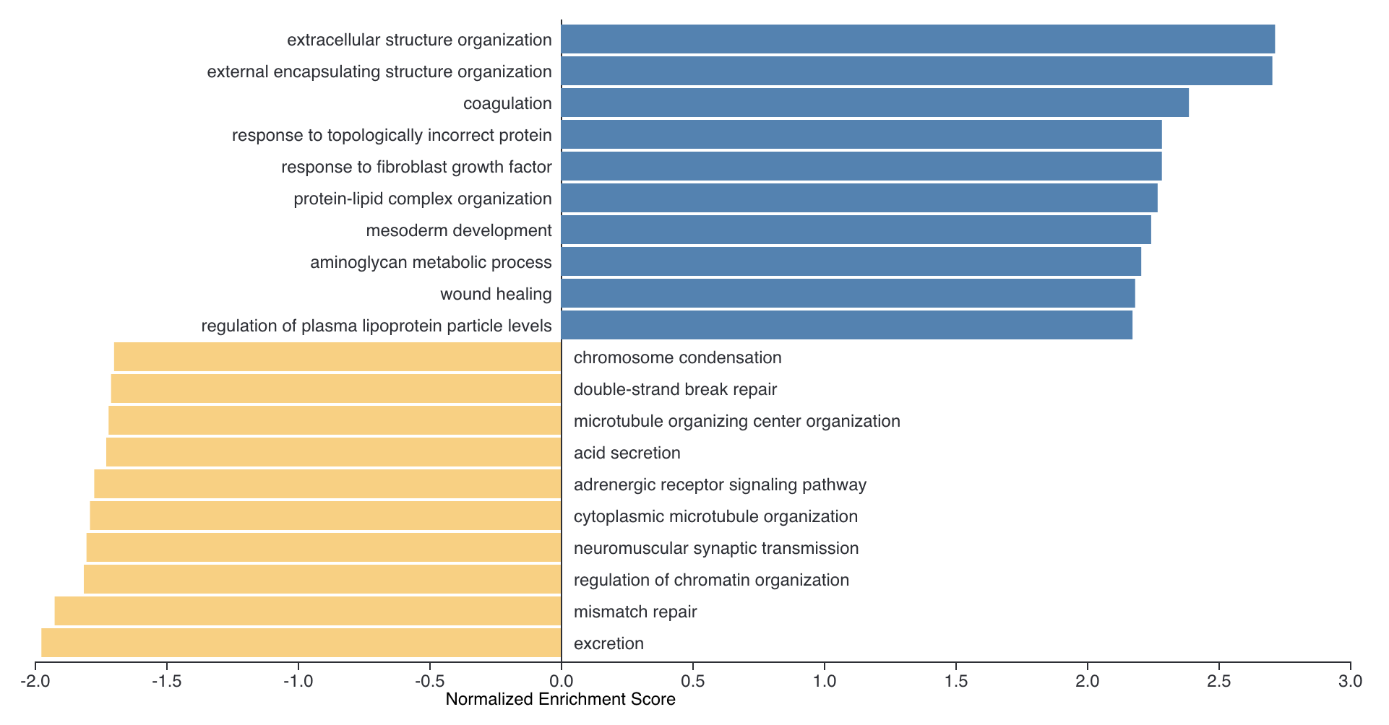
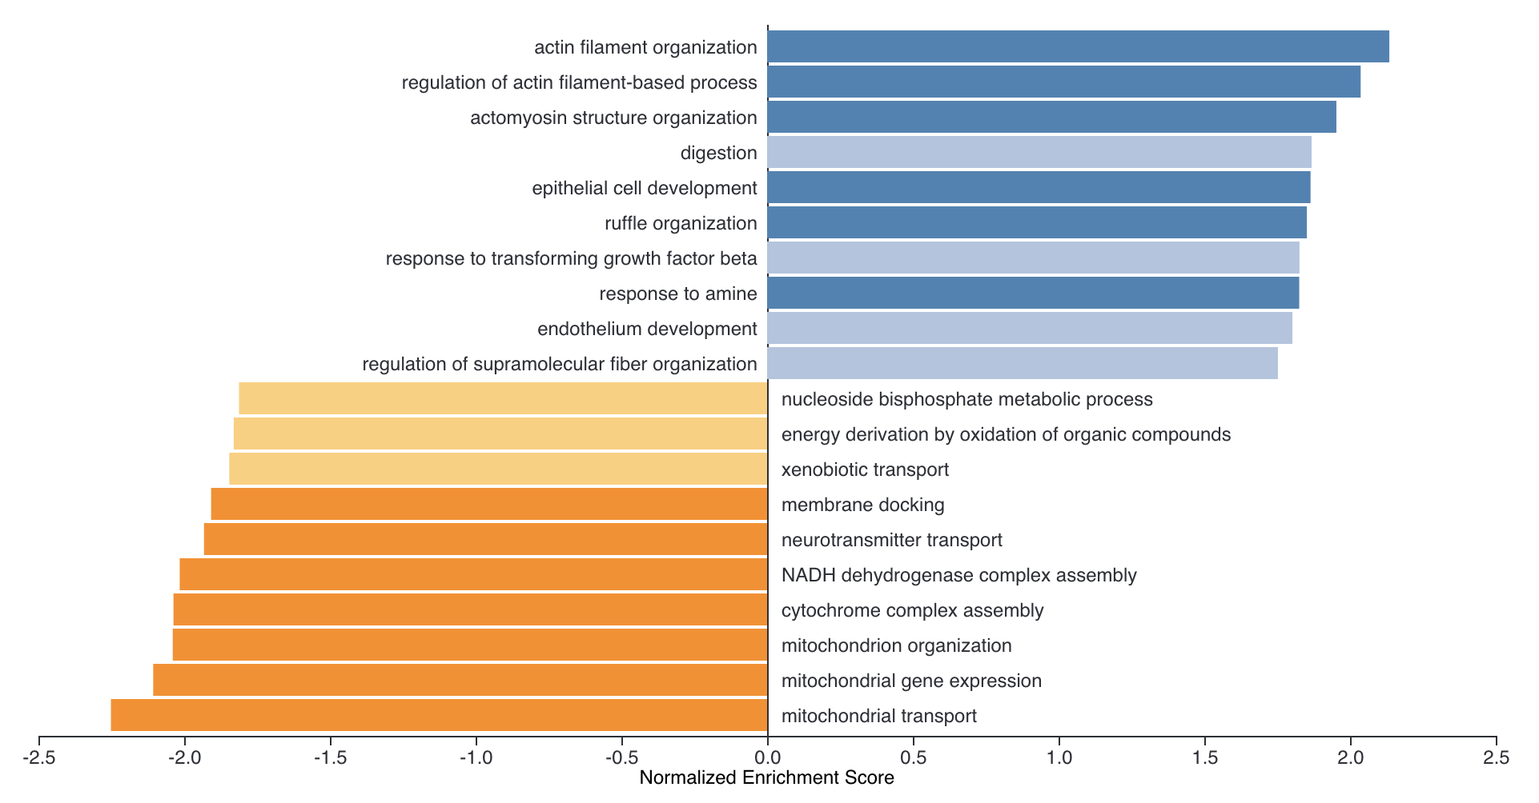
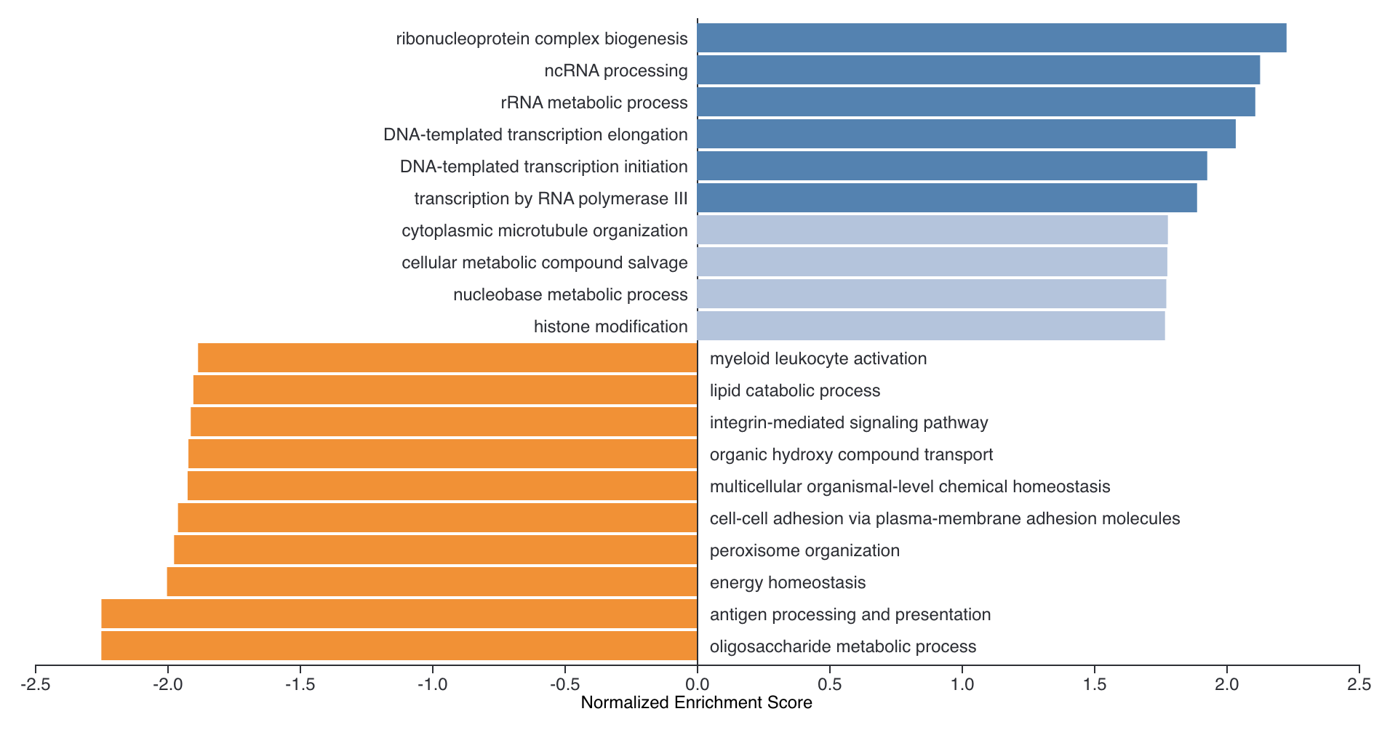
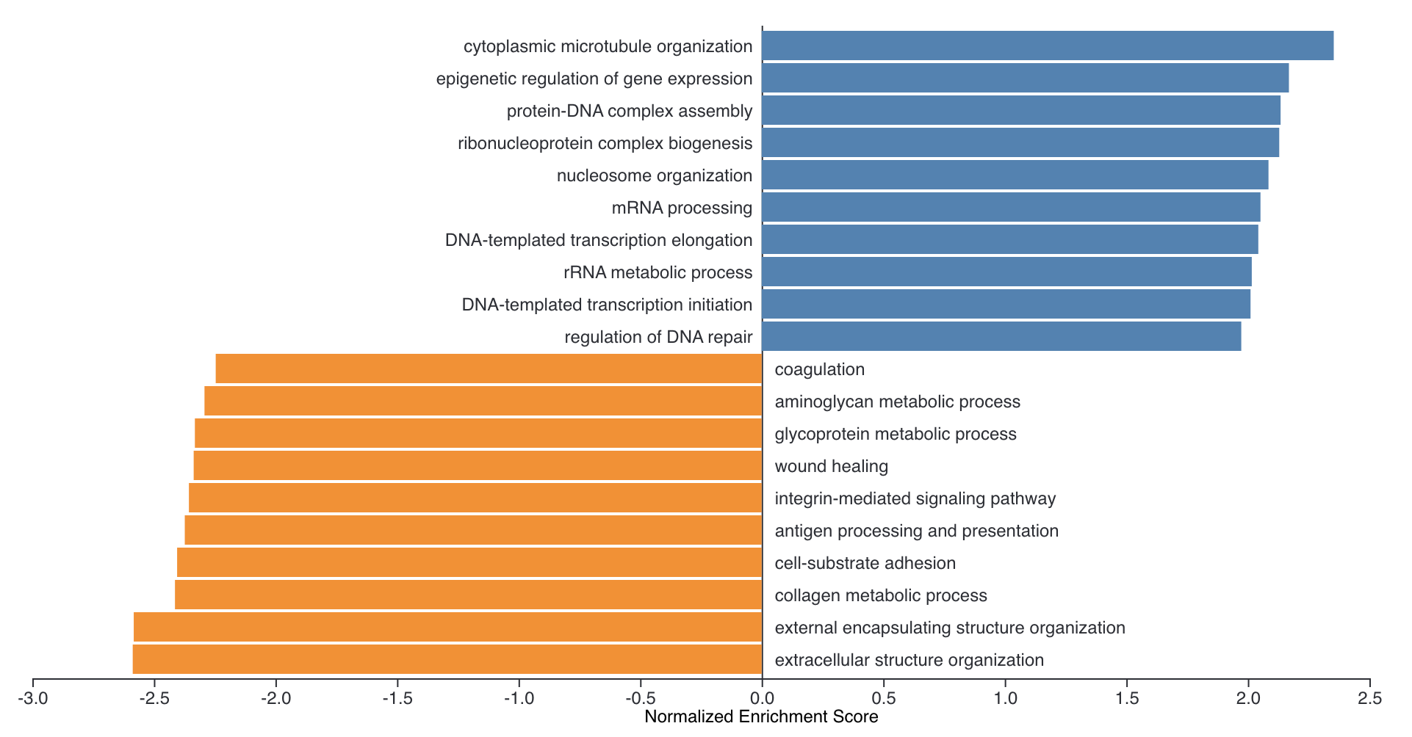
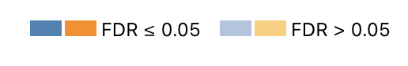
GO: Biological_Process_noRedundant
Atto vs. Negative
mScarlet vs. Negative
mScarlet vs. Atto
LV_KD vs. Negative
LV_KD vs. Atto
LV_KD vs. mScarlet
up
down
Notes:
Atto vs. Neg | mScarlet vs. Neg | mScarlet vs. Atto | LV vs. Neg | LV vs. mScarlet
omitted for now: LV vs. Atto

Slide 6
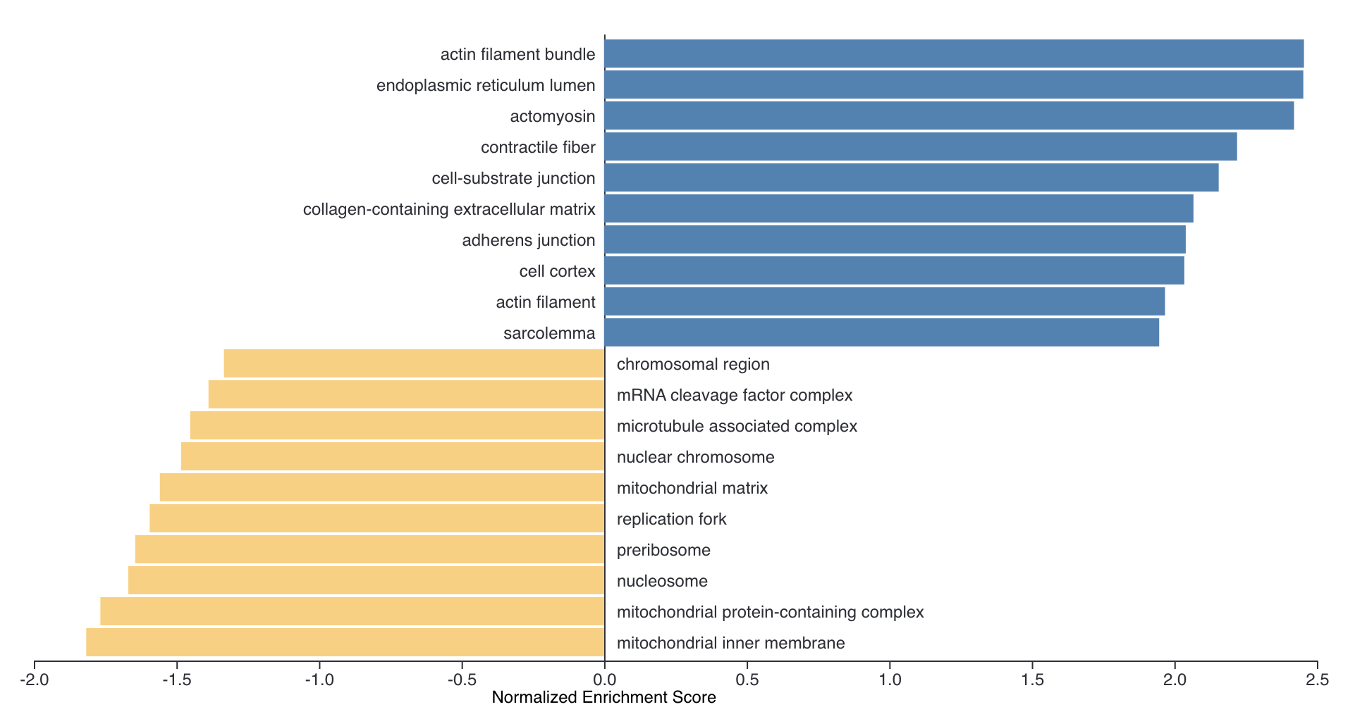
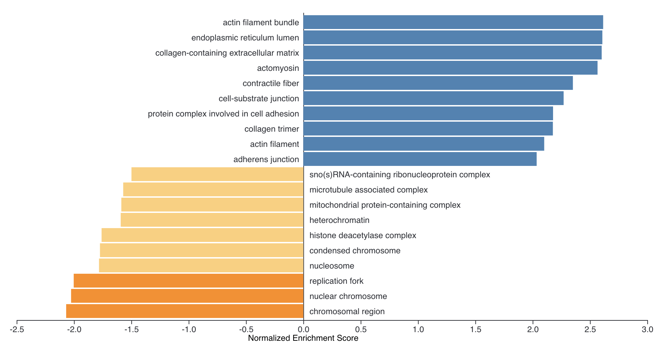
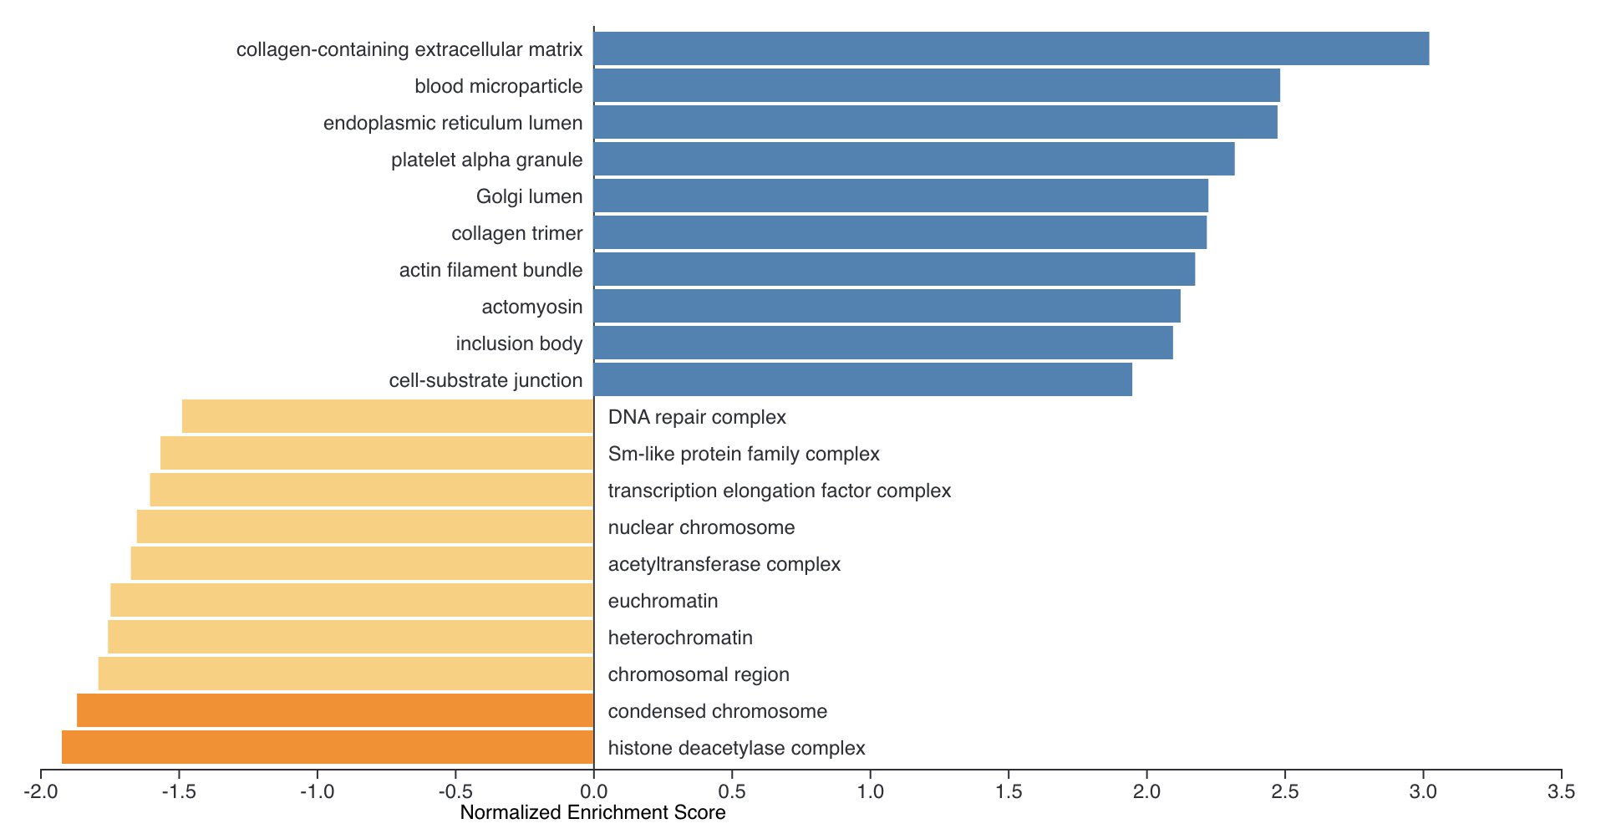
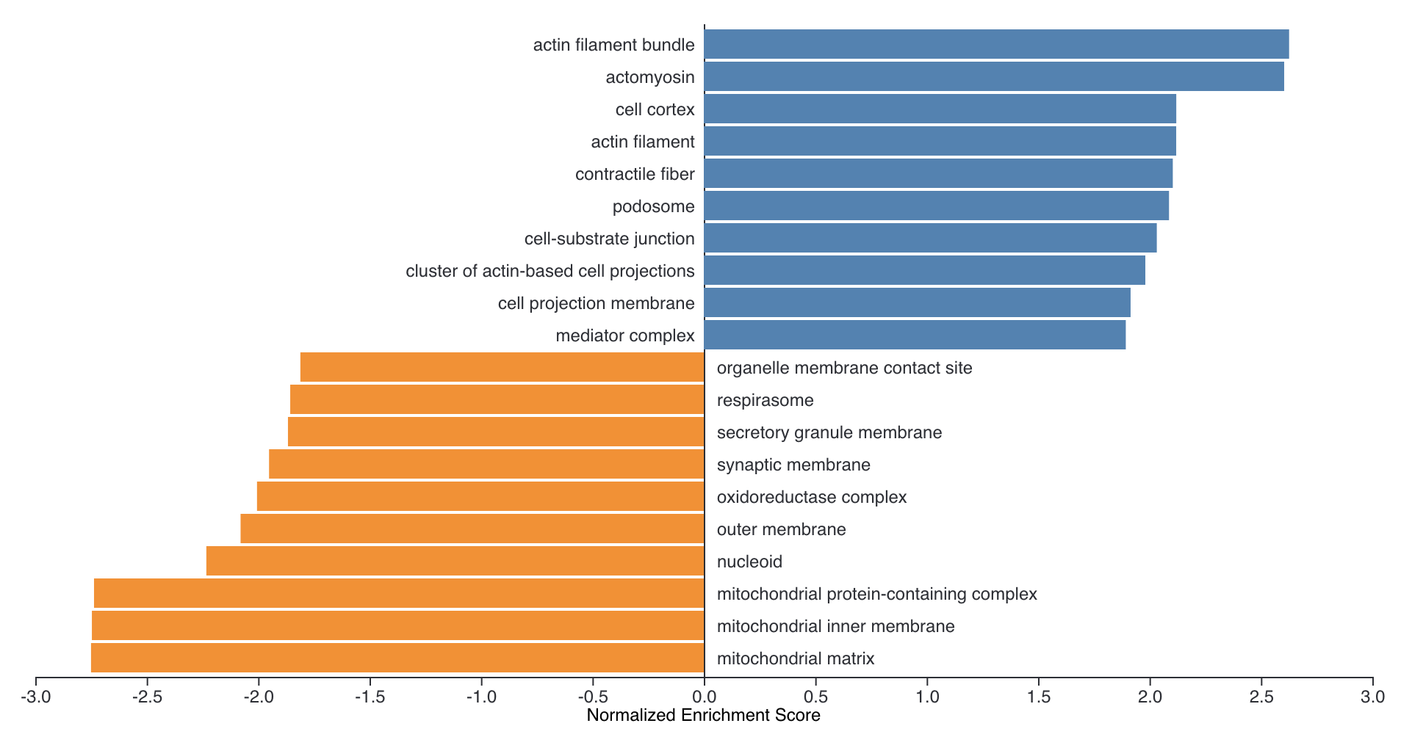
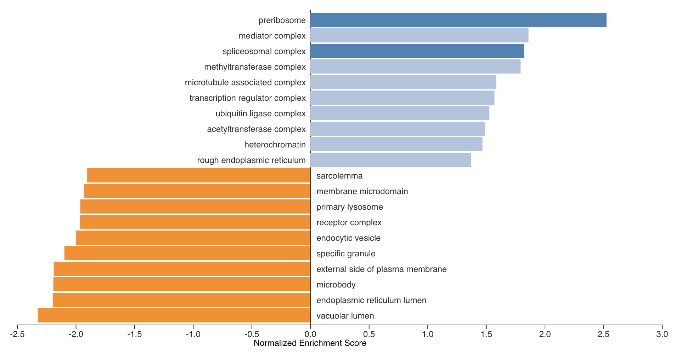
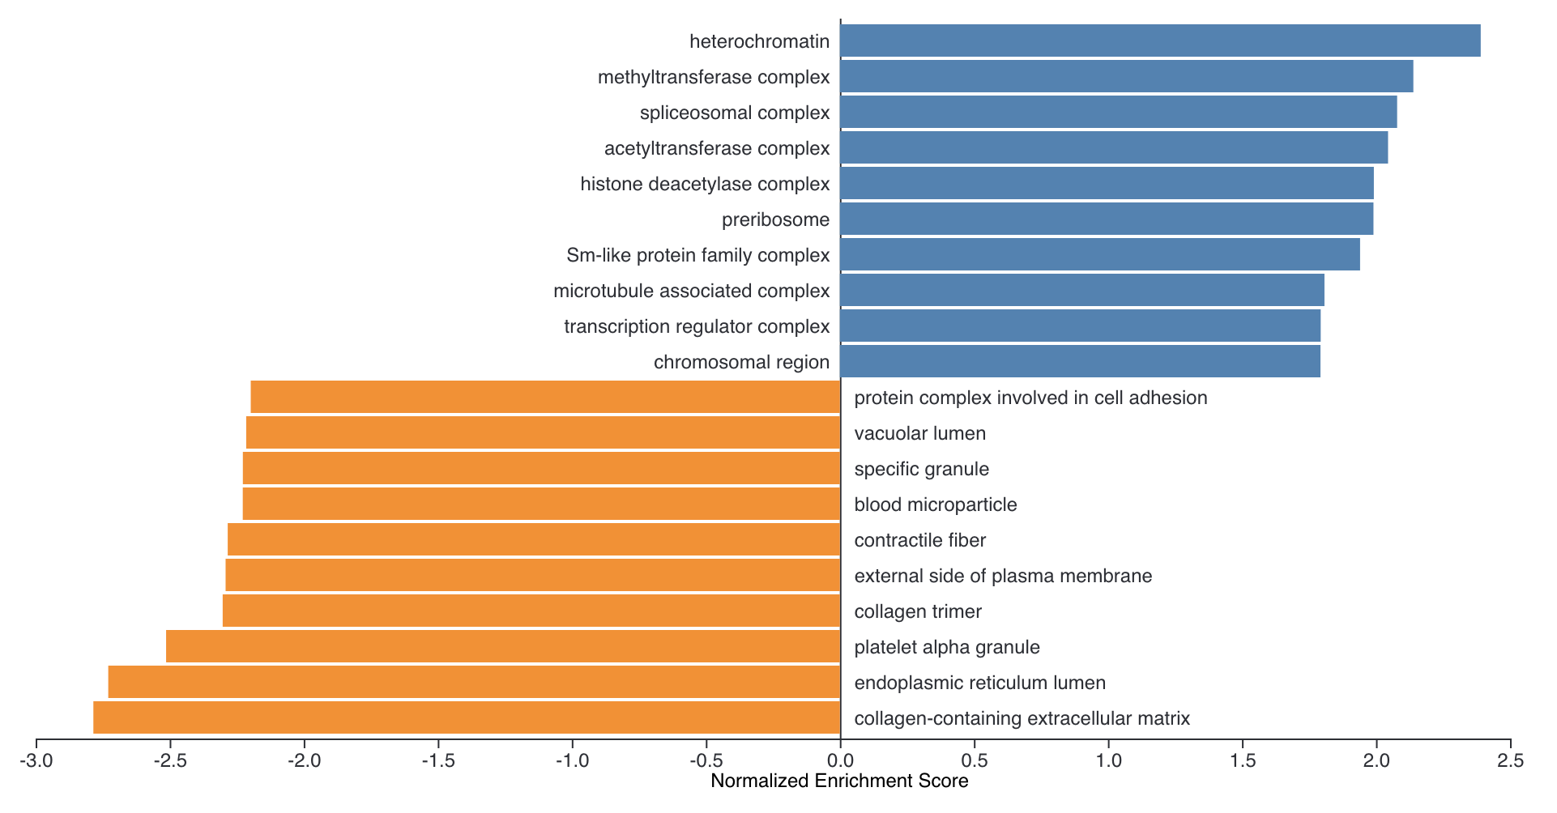
GO: Cellular_Component_noRedundant
Atto vs. Negative
mScarlet vs. Negative
mScarlet vs. Atto
LV_KD vs. Negative
LV_KD vs. Atto
LV_KD vs. mScarlet

Slide 7
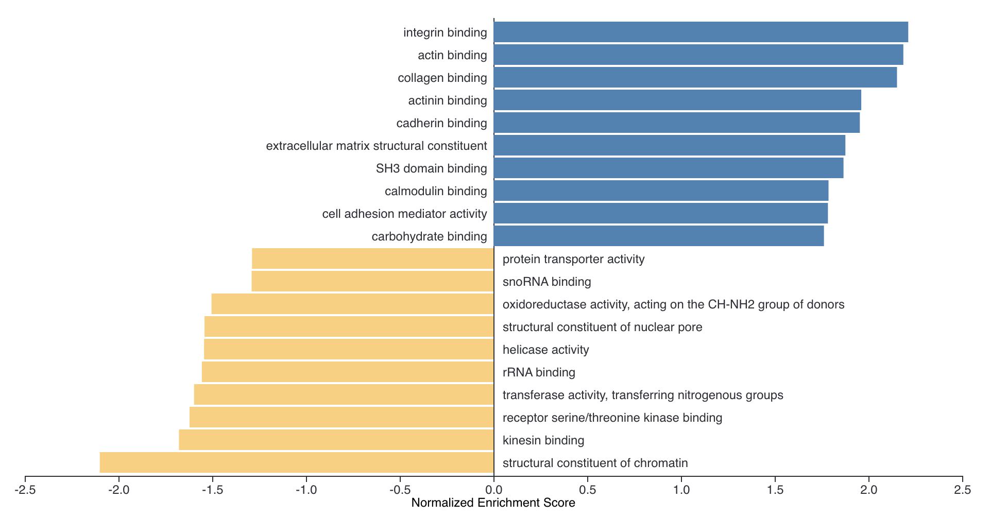
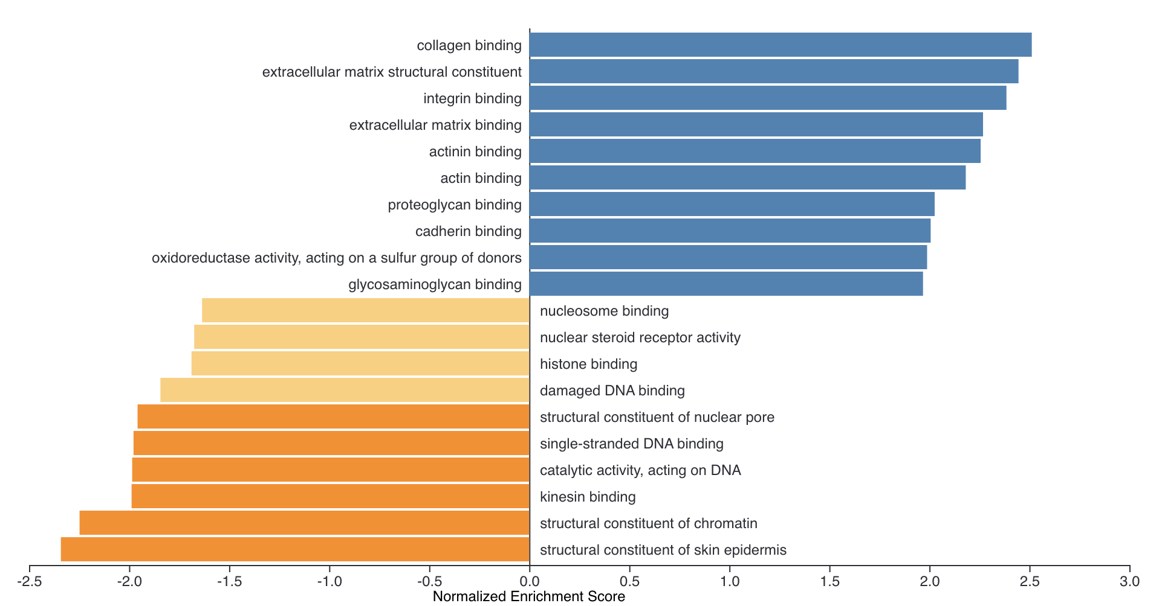
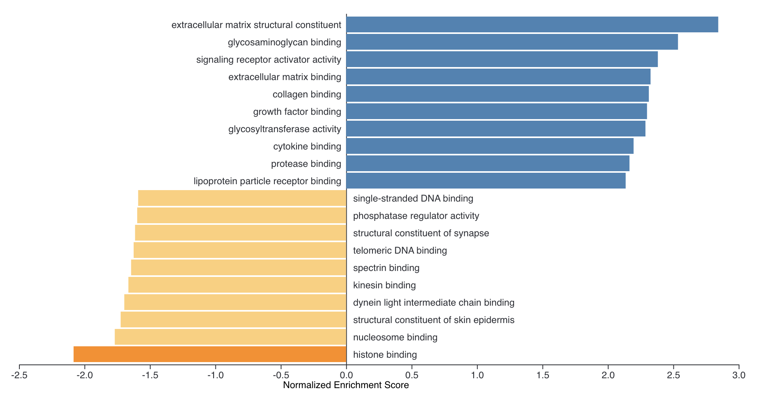
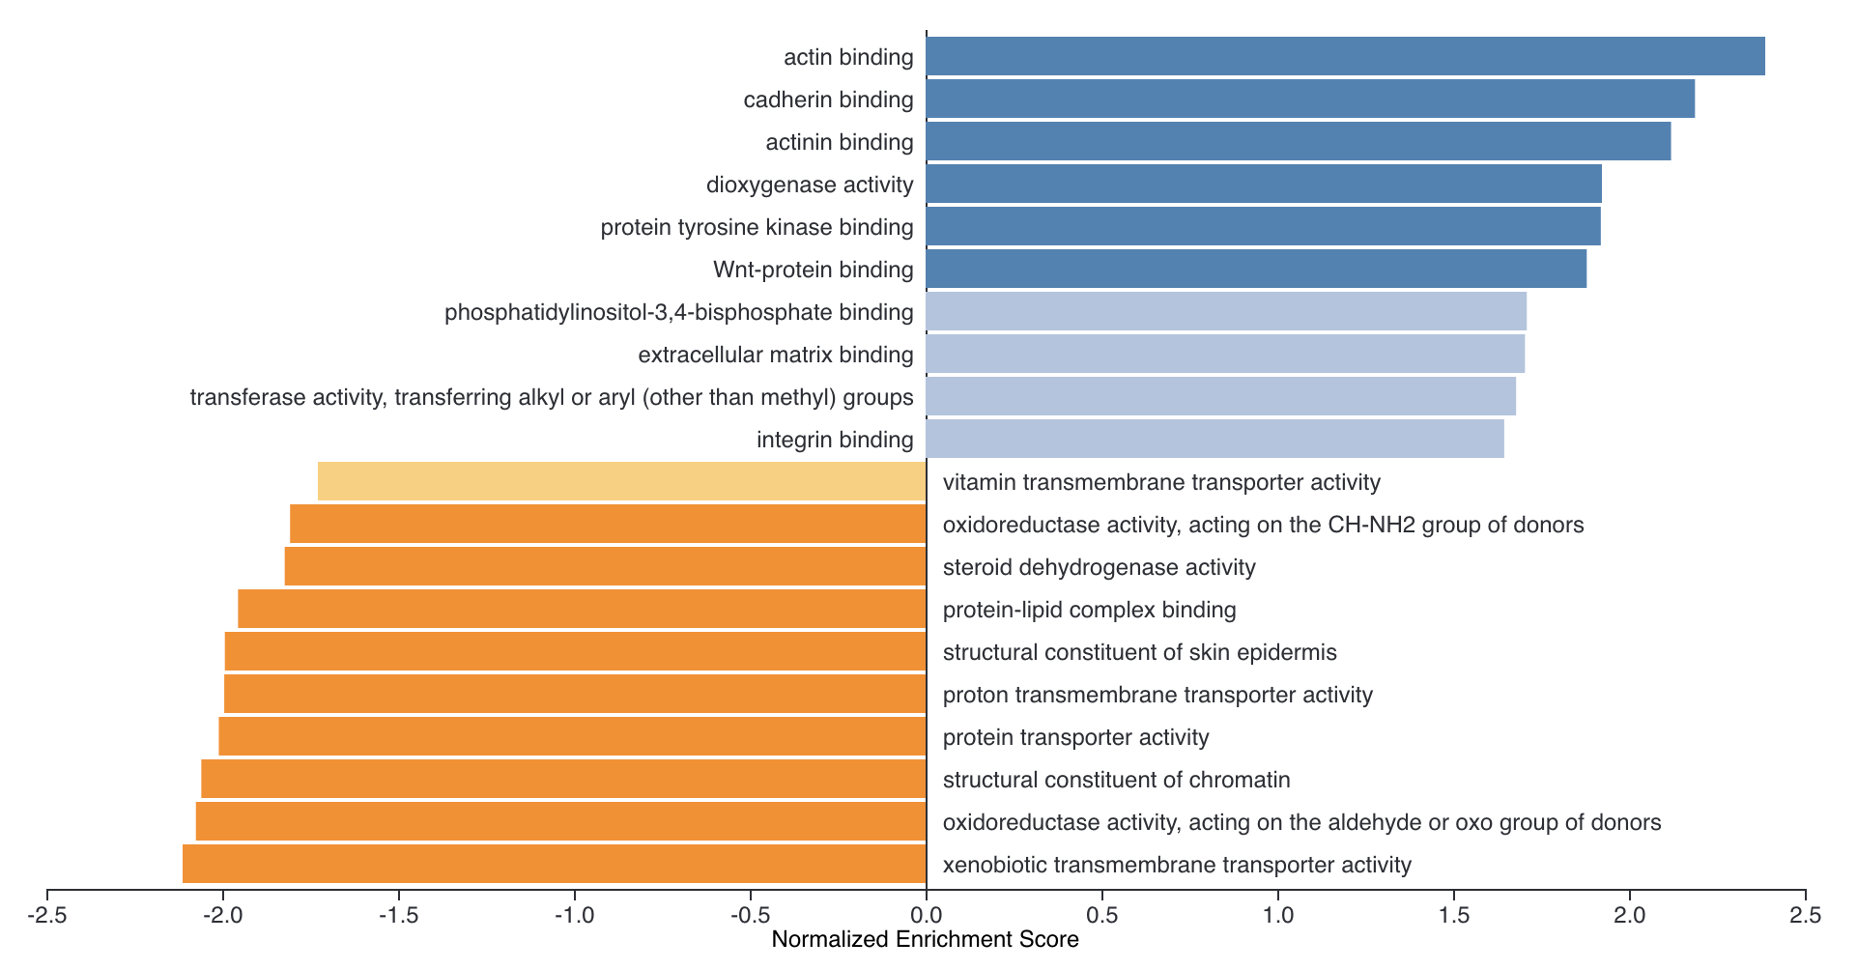
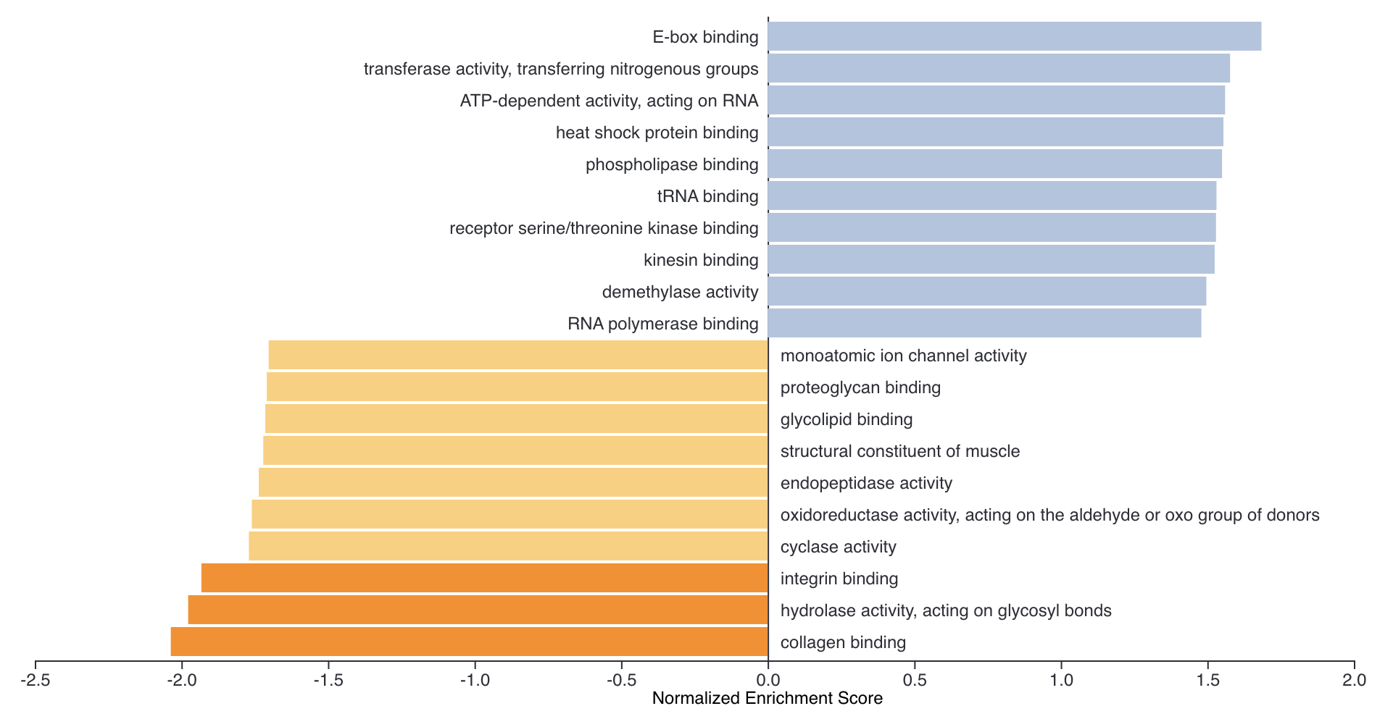
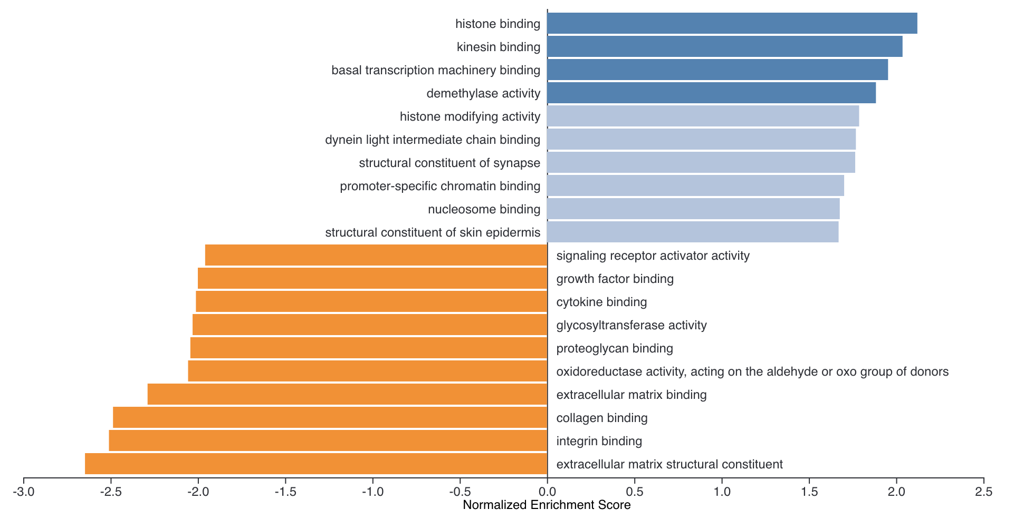
GO: Molecular_Function_noRedundant
Atto vs. Negative
mScarlet vs. Negative
mScarlet vs. Atto
LV_KD vs. Negative
LV_KD vs. Atto
LV_KD vs. mScarlet

Slide 8
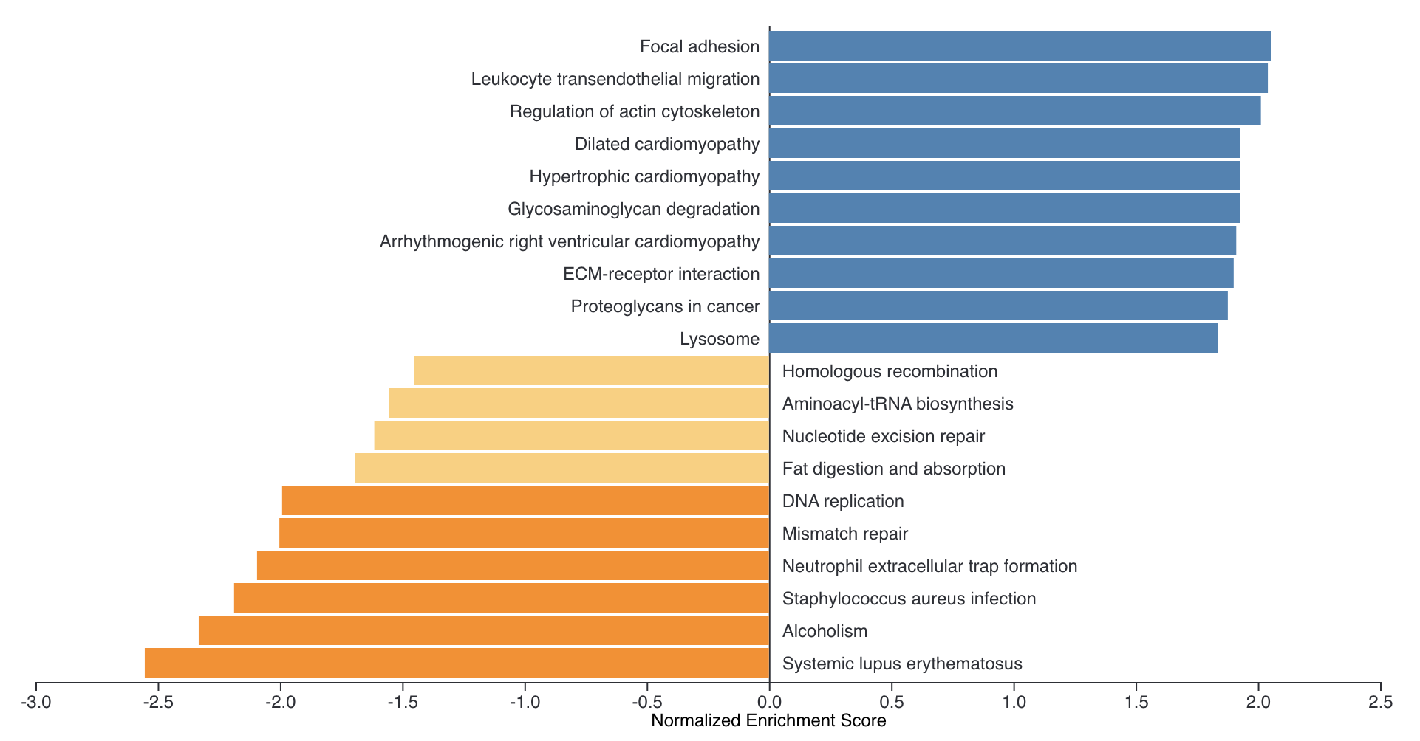
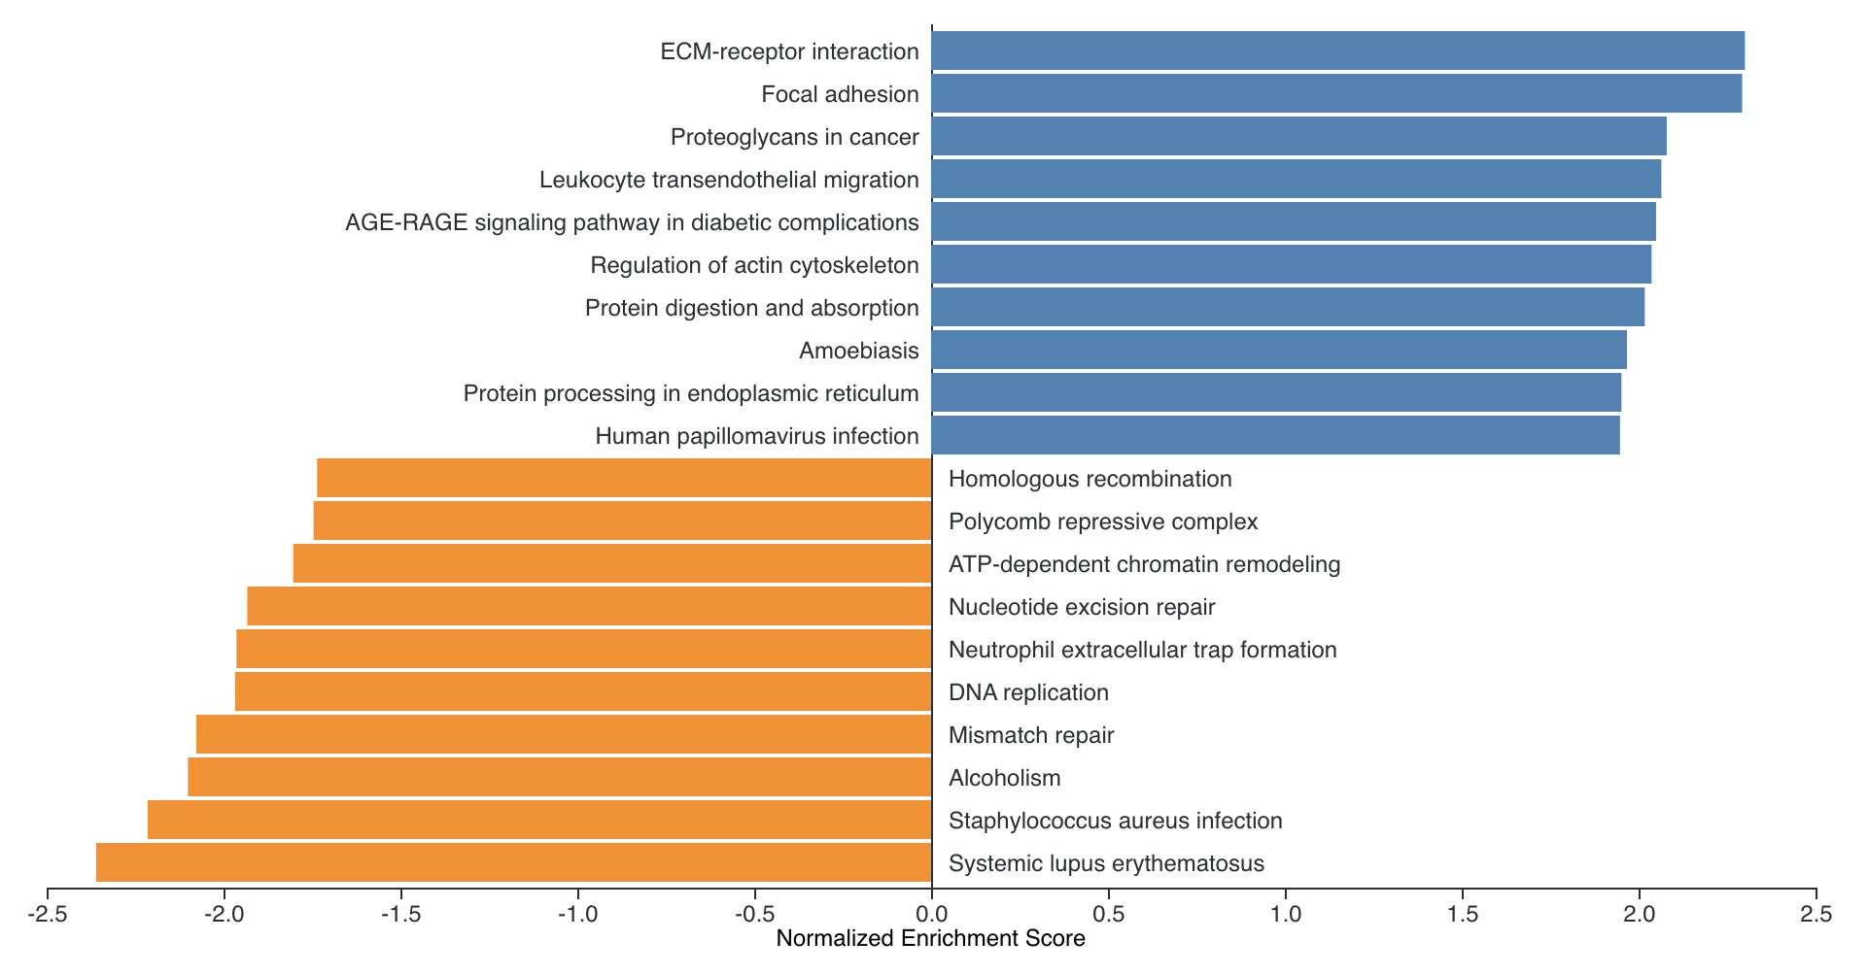
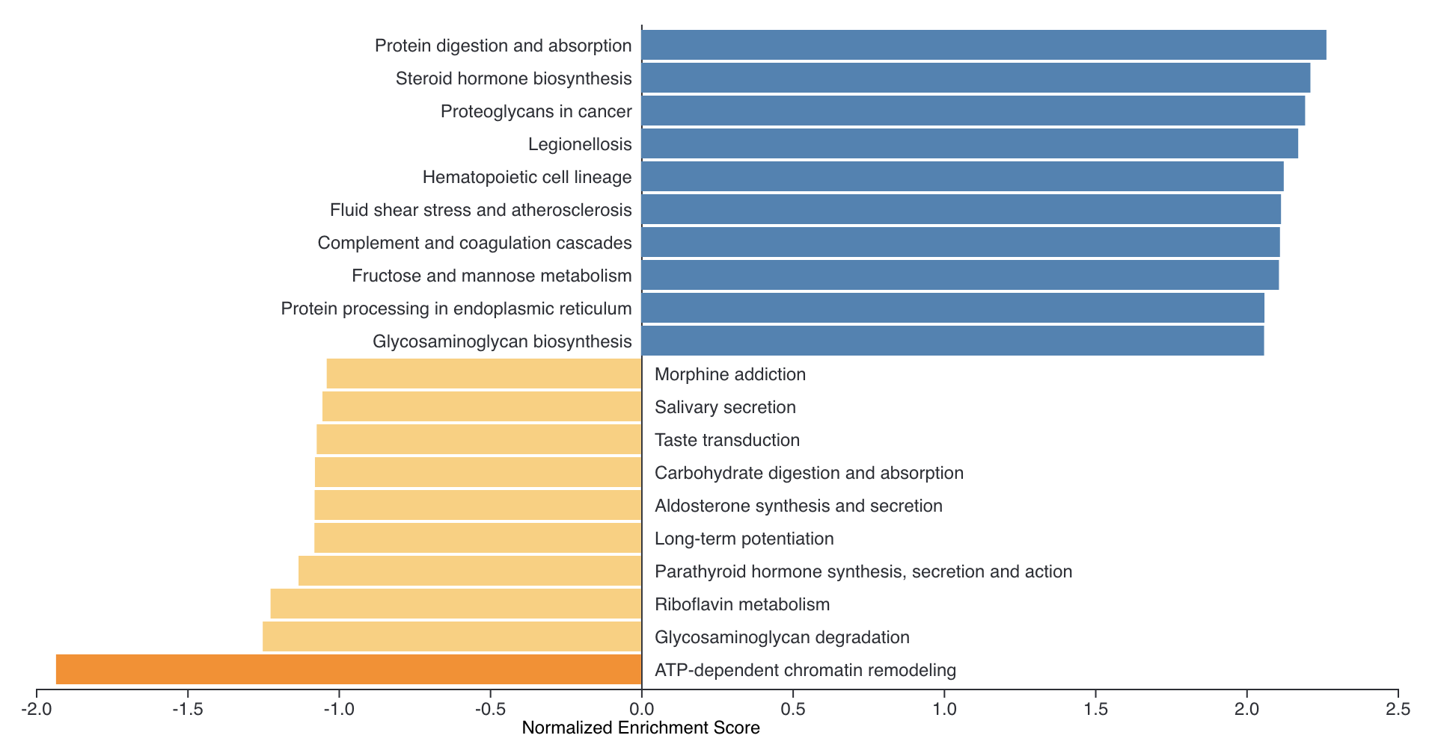
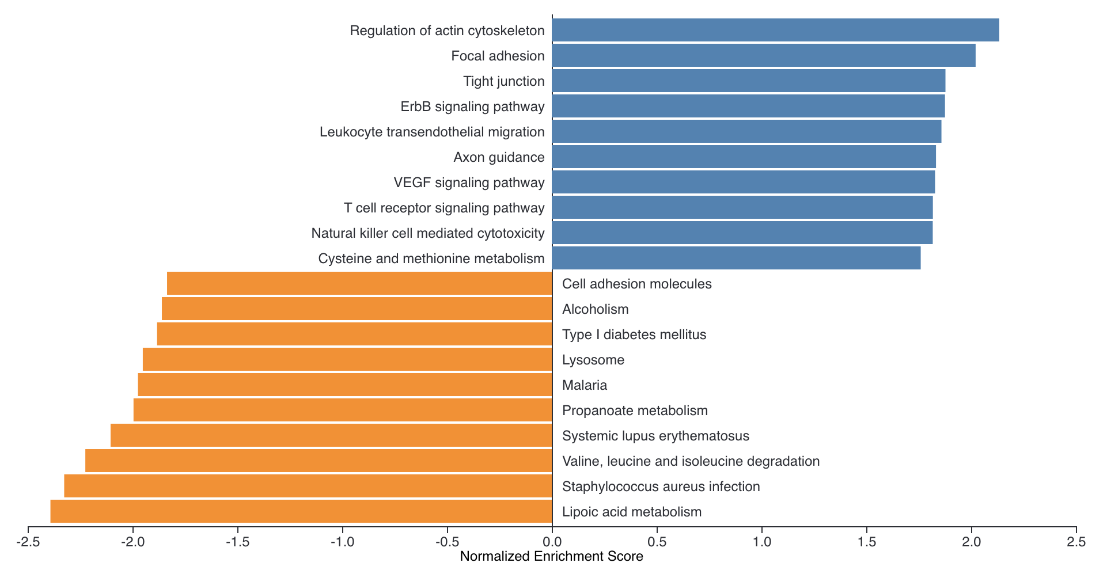
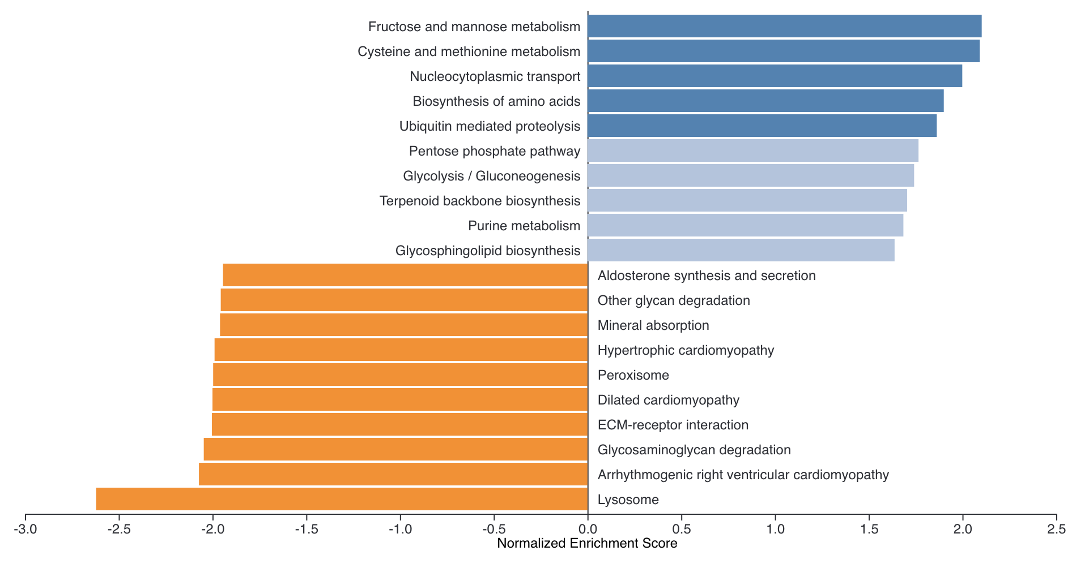
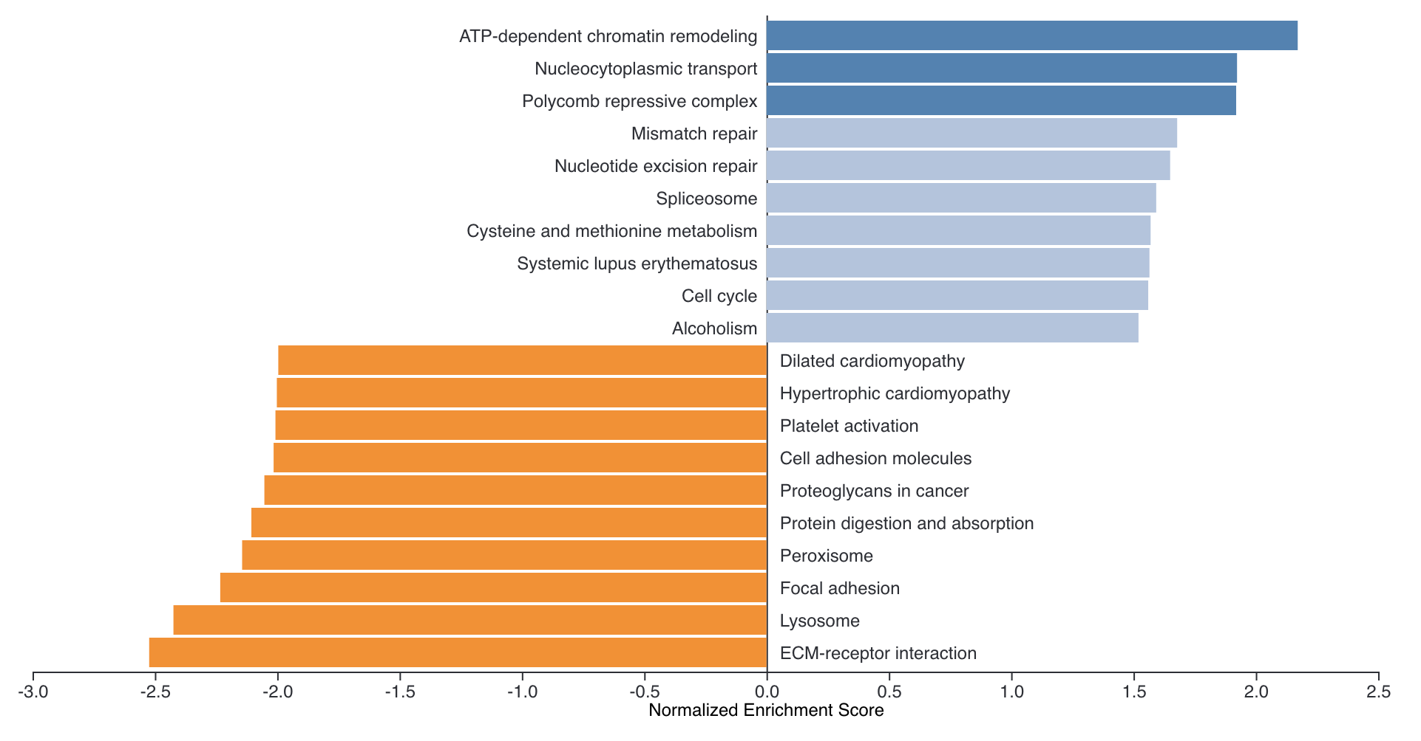
GO: KEGG
Atto vs. Negative
mScarlet vs. Negative
mScarlet vs. Atto
LV_KD vs. Negative
LV_KD vs. Atto
LV_KD vs. mScarlet

Slide 9
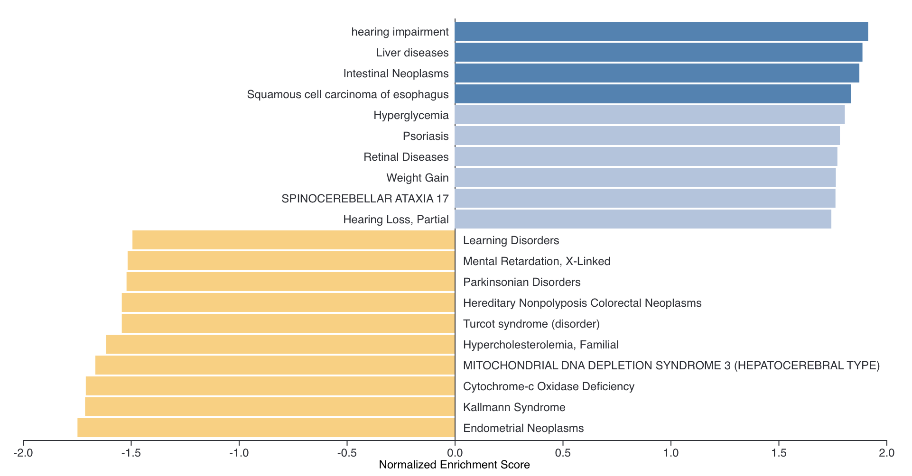
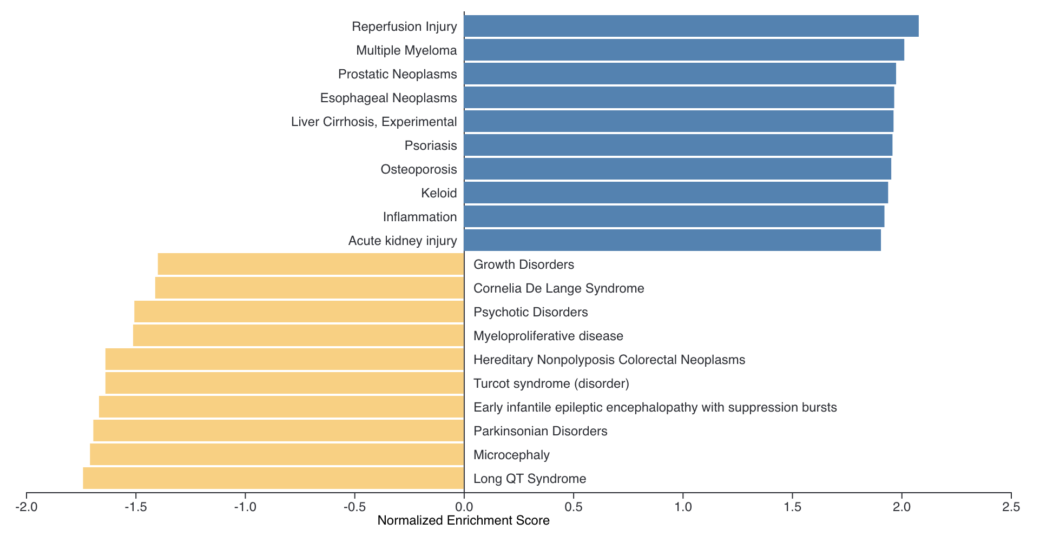
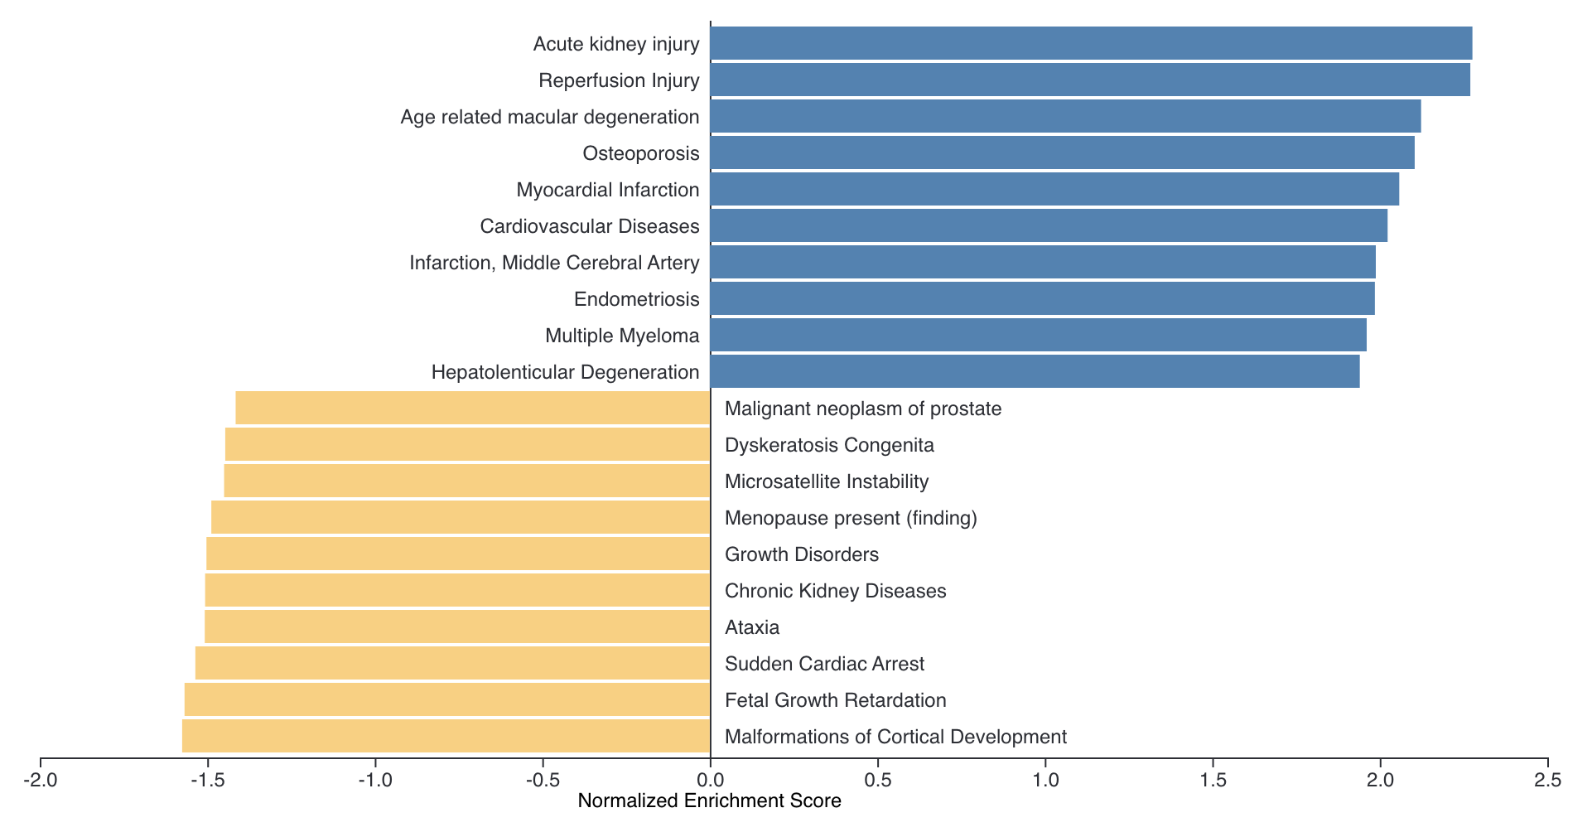
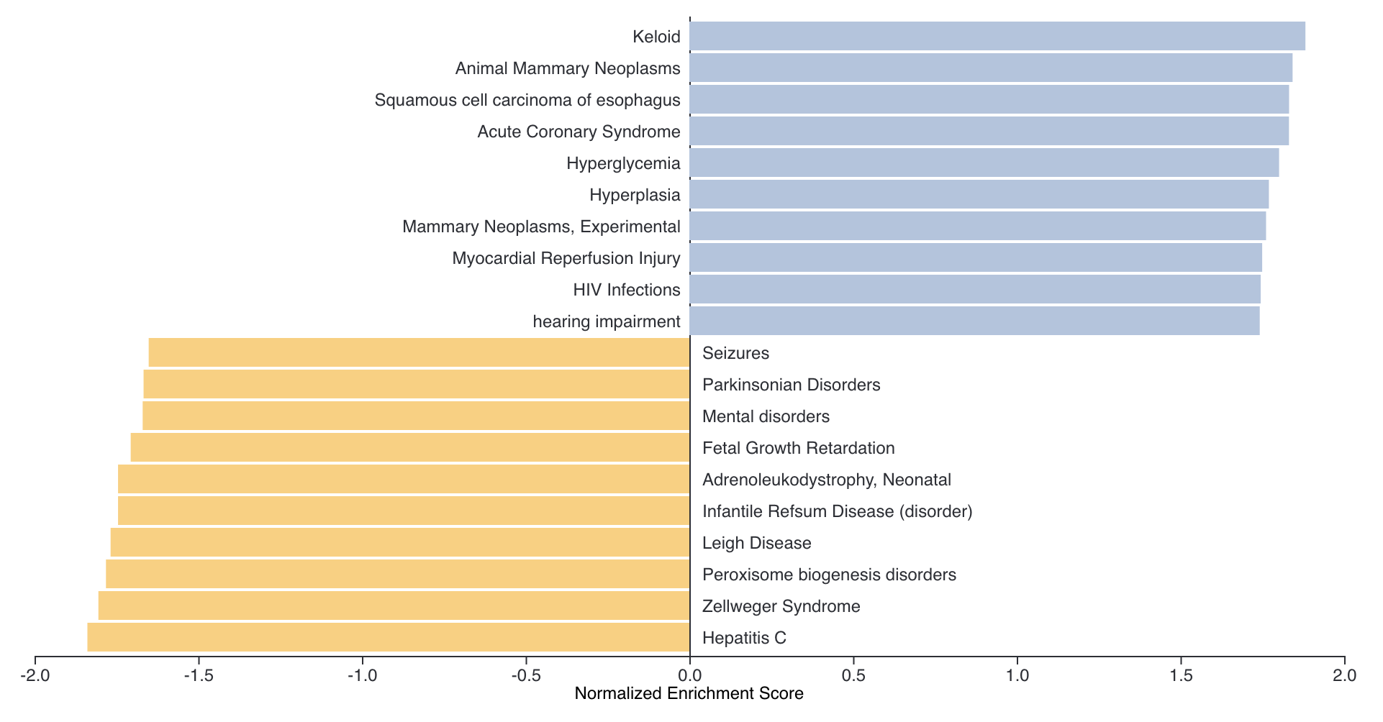
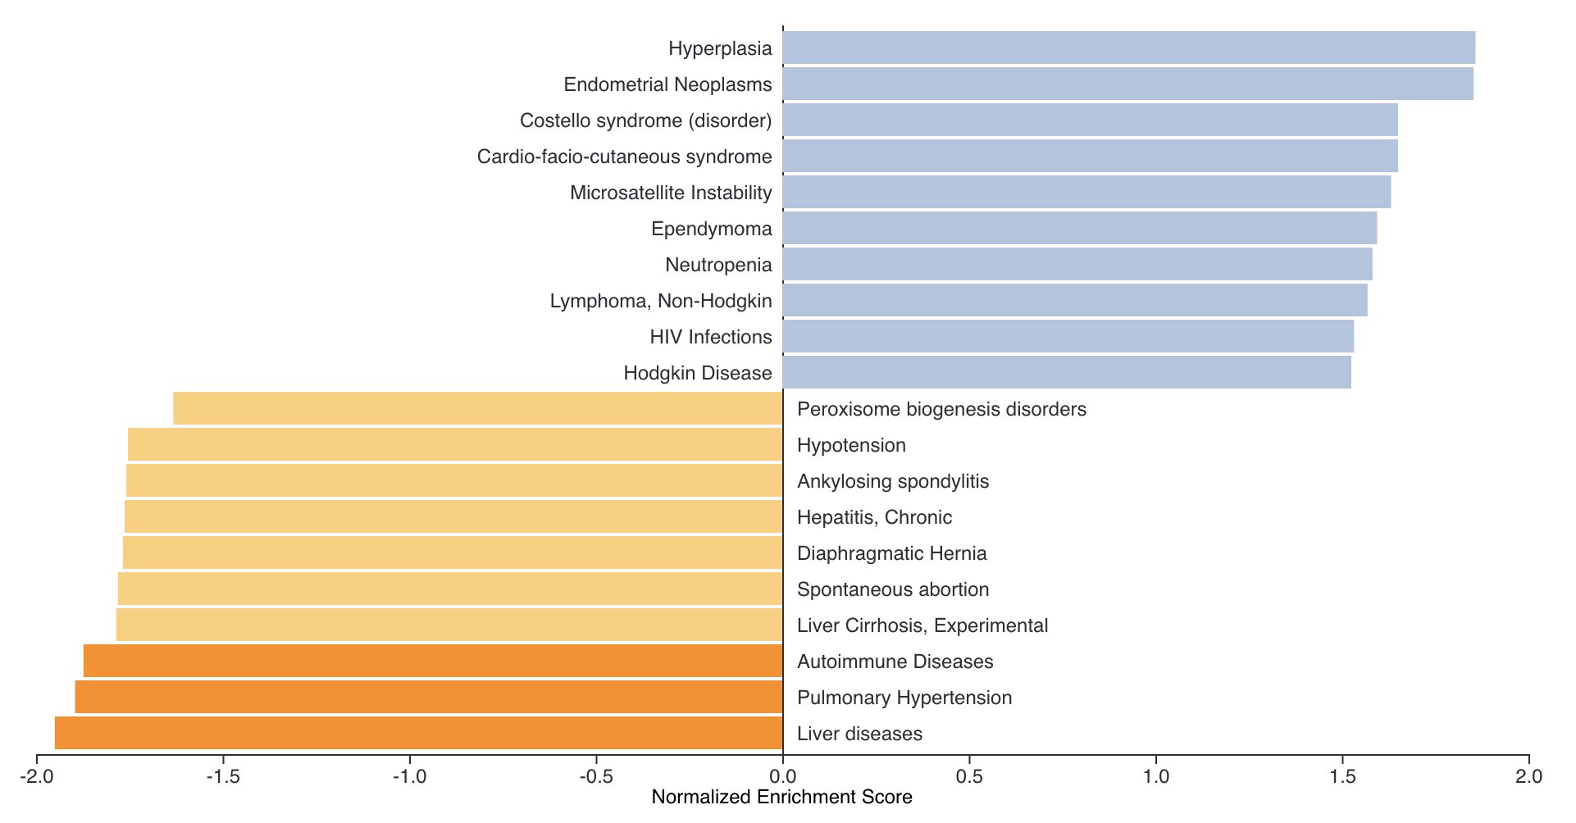
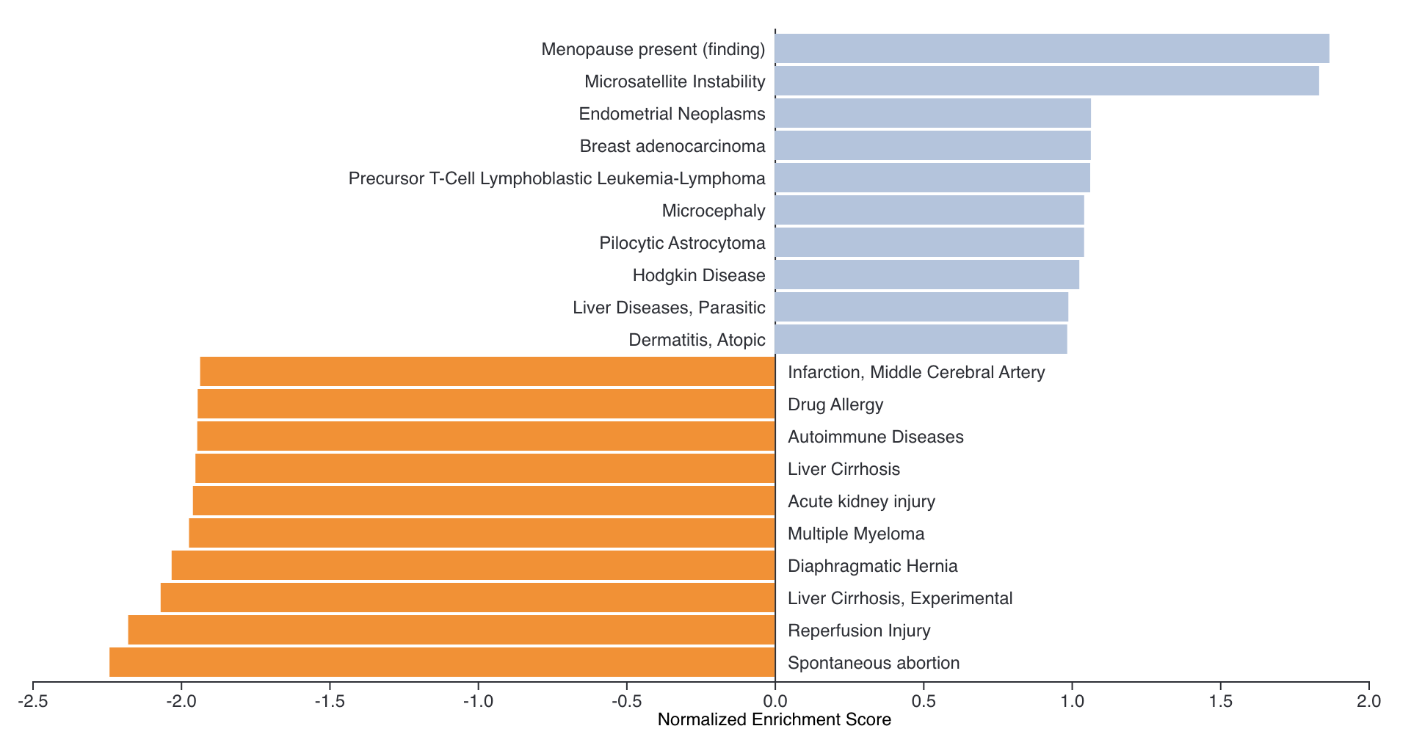
GO: disease_Disgenet
Atto vs. Negative
mScarlet vs. Negative
mScarlet vs. Atto
LV_KD vs. Negative
LV_KD vs. Atto
LV_KD vs. mScarlet

